Slide 1
Evolution at Multiple Loci:
Quantitative Genetics

Slide 2
I. Rediscovery of Mendel and Challenges to Natural Selection
Do traits that exhibit continuous variation have a genetic basis?
If the only traits which have genetic variation are controlled by one or two loci then natural selection not as important as mutation
Darwin envisioned evolution to be a continuous process of selection acting on limitless genetic variation, with small changes occurring in any one generation, but large changes occurring over long periods.

Slide 3
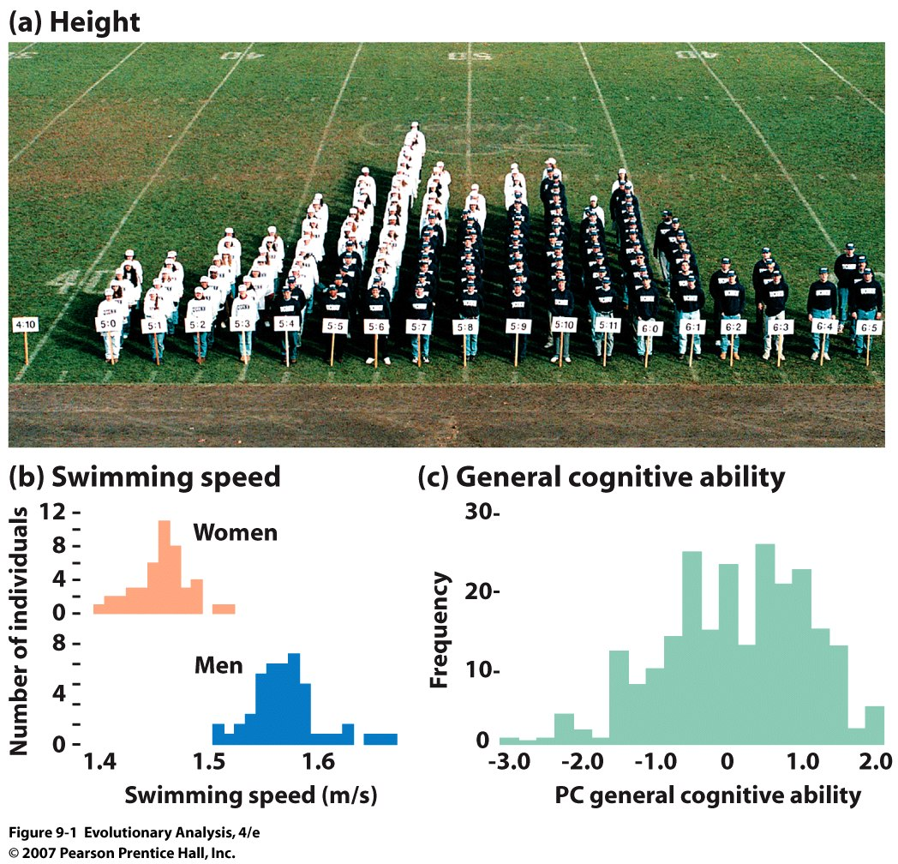
Why the normal distribution: Central Limit Theorem
Notes:
Figure 9.1 Some quantitative traits in humans
(a) These students and faculty at the University of Connecticut have formed a living histogram by arranging themselves into columns by height. The women are wearing white shirts; the men are wearing blue. (b) These graphs show the variation in average speed over a distance of 1,500 meters for swimmers who competed in the finals at the 2002 Phillips 66 Summer Nationals. Plotted from data found at http://www.usaswimming .org/fast_times/template.pl?opt= results&eventid=471. (c) This graph shows the variation in general cognitive ability, assessed as a statistical composite of scores from a variety of tests, for Swedish participants in a twin study. For more details see Twins in Section 9.3. Rerendered from McClearn et al. (1997).

Slide 4
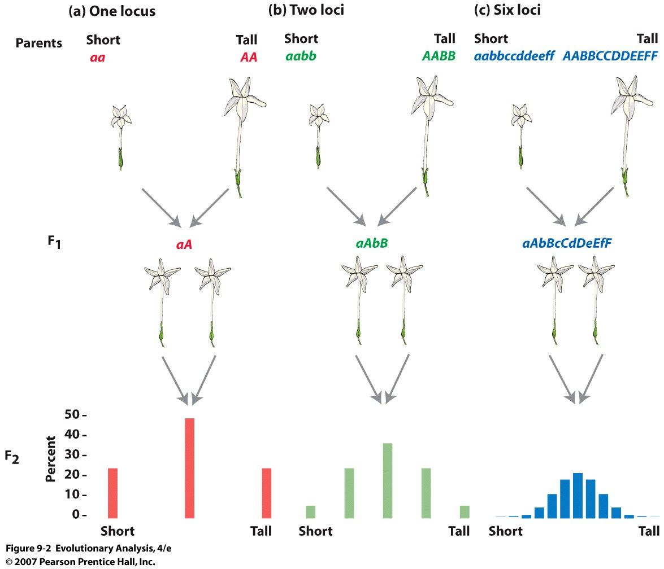
Mendelian genetics can explain quantitative traits
Ex. 1: NILSSON-EHLE: Red and White Kernel Color in Wheat
(red dominant, white recessive)
Ex. 2:
East’s work
with tobacco
Notes:
Figure 9.2 Mendelian genetics can explain quantitative traits
(a), (b), and (c) show the predicted genotypes and phenotypes for parental, F₁, and F₂ plants under Mendelian models in which corolla length is determined by the alleles at one, two, and six loci.
See text for more details.
Kernel color is an important discriminator among U.S. market classes of wheat. It may vary from a dark reddish hue, all shades of which are classified as "red", to light or amber (white). White kernel color offers potential for improved milling performance over red wheat in the form of higher flour yield, because a slightly higher flour extraction rate may be used without sacrificing flour color. International markets often prefer white wheat over red wheat, particularly in Asian countries where steamed bread, flat bread, and noodle products predominate.
Classical work on the genetics of wheat kernel color by Nilsson-Ehle (1909) showed that red color is controlled by three loci with partial dominance. Each locus resides on a different chromosome of homeologous Group 3 (Sears, 1944; Metzger and Silbangh, 1970). However, expression is more complex because of additional minor genes; perhaps as many as six genes may influence kernel color (Freed et al., 1976; Reitan, 1980).
Kernel color is highly heritable (Cooper and Sorrells, 1984), but gene expression is not independent of environmental effects. For example, Wu et al. (1987) found that kernel color of white cultivars from northern China was darker when grown in the more humid region of the Lower Yangtze Valley. When produced in Colorado, grain samples of `Klasic', a hard white spring cultivar, have not shown the typical white color associated with the cultivar when grown in California (T.J. Martin, 1994, personal communication). Therefore, the magnitude of environmentally induced kernel color variation and the interaction between genotype and environment, deserve close attention in the Great Plains of the USA where visual segregation of HWW wheat from the more dominant HPW class is critical. Slight changes in color of HWW grain may impede proper classification and successful marketing. Environmental effects also could bias selection of candidate HWW cultivars.

Slide 5
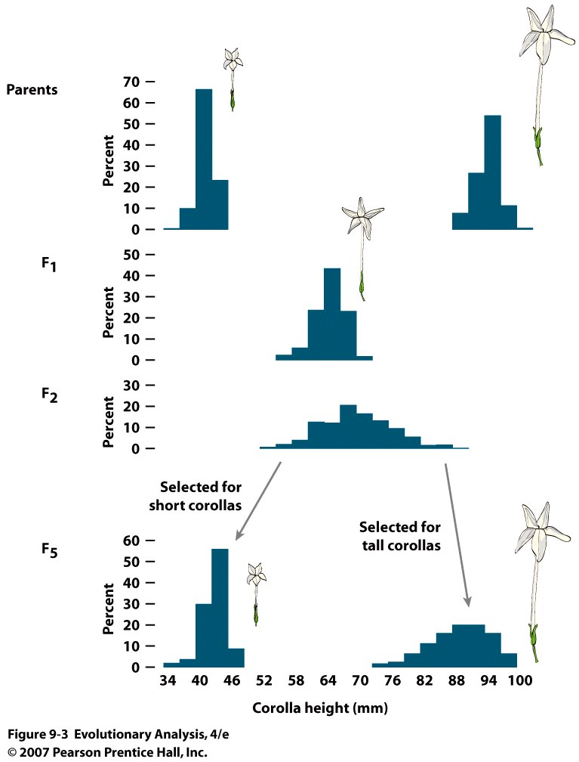
Notes:
Figure 9.3 Edward East's data confirm the predictions of the Mendelian model in Figure 9.2c
East crossed short and long-flowered parental plants to produce medium-flowered F₁s. He then selfed the F₁s, which produced an F₂ generation that was more variable than the F₁ generation, but did not approach the extremes of the parental strains. Finally, East recovered the parental phenotypes by selectively breeding from the F₂ plants. Drawn from data in Table 1 of East (1916); after Ayala (1982).
6 loci: total of 1-12 pluses and zero: = 13 phenotypes

Slide 6
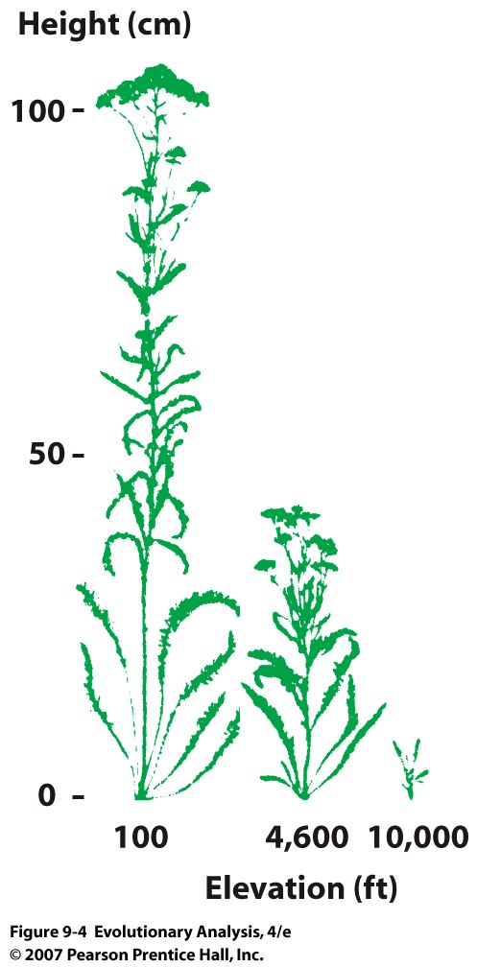
Quantitative traits are influenced by the environment as well as genotype
Yarrow plant
Notes:
Figure 9.4 Quantitative traits are influenced by the environment as well as genotype
These three yarrow plants were grown from cuttings of the same individual, and are thus genetically identical. Reared at different altitudes, they show dramatic differences in height. Reprinted from Clausen, Keck, and Hiesey (1948).

Slide 7
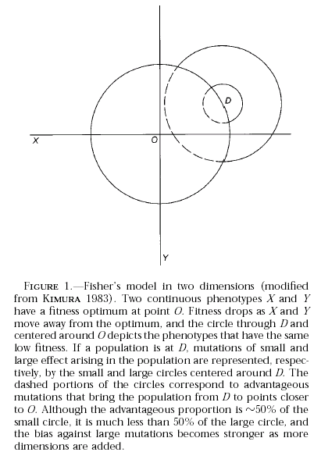
II. Neo Darwinian Synthesis
Theoretical models that support vs. contend the Darwinian model
1. Fisher’s prediction
2. Kimura’s
modification
Probability of Fixation
Mutation Effect
3. Orr’s modification

Slide 8
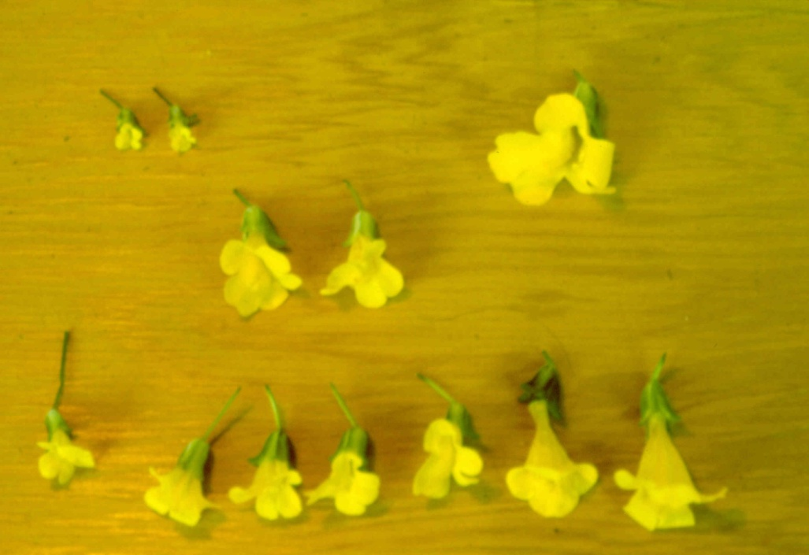
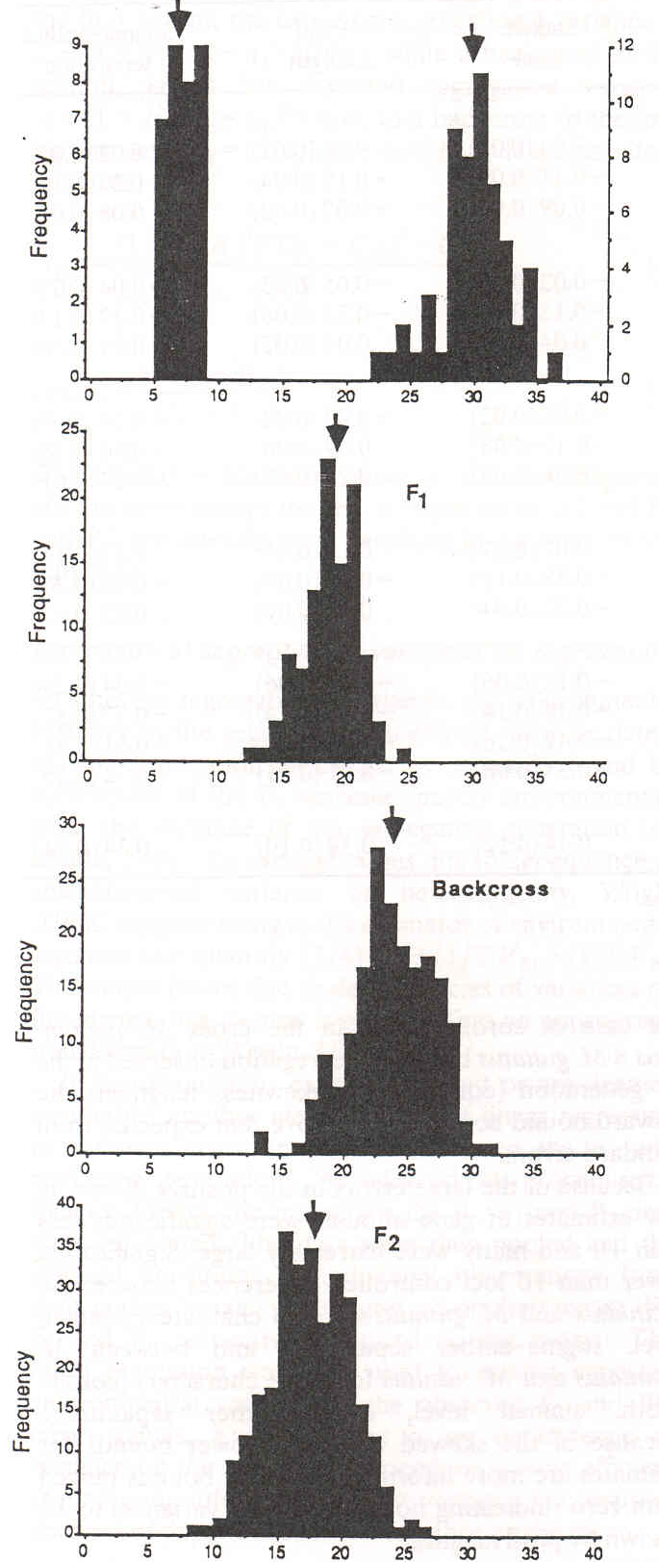
Typical results
Testing the Models:
M. micranthus M. guttatus
F1
F1
F2
BC
F2
Fenster & Ritland 1994
Corolla Width (mm)

Slide 9
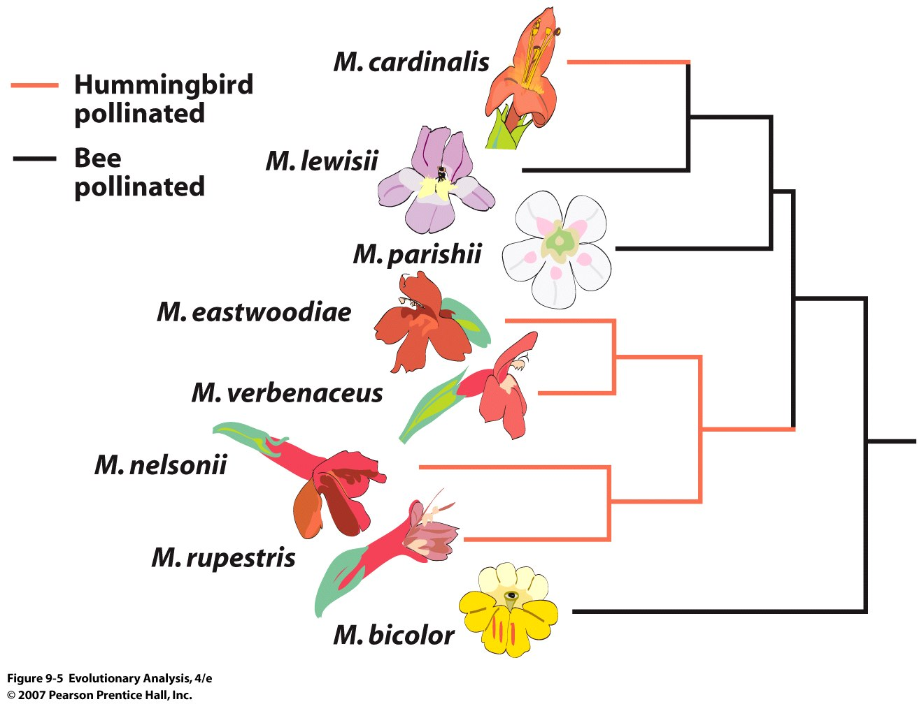
Notes:
Figure 9.5 A phylogeny of Mimulus cardinalis, Mimulus lewisii, and kin
The common ancestor of these species was pollinated by bees. Pollination by hummingbirds evolved twice: once in the common ancestor of M. eastwoodiae and kin, and once in M. cardinalis. What genes are involved and what are their effects? After Beardsley et al. (2003).

Slide 10
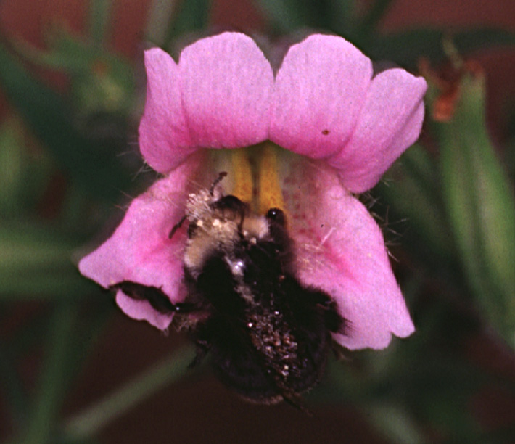

Slide 11
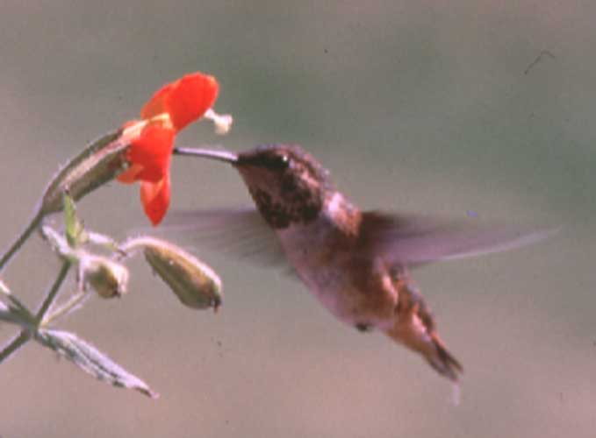

Slide 12
No filter
Filtered image—
“bumblevision”

Slide 13
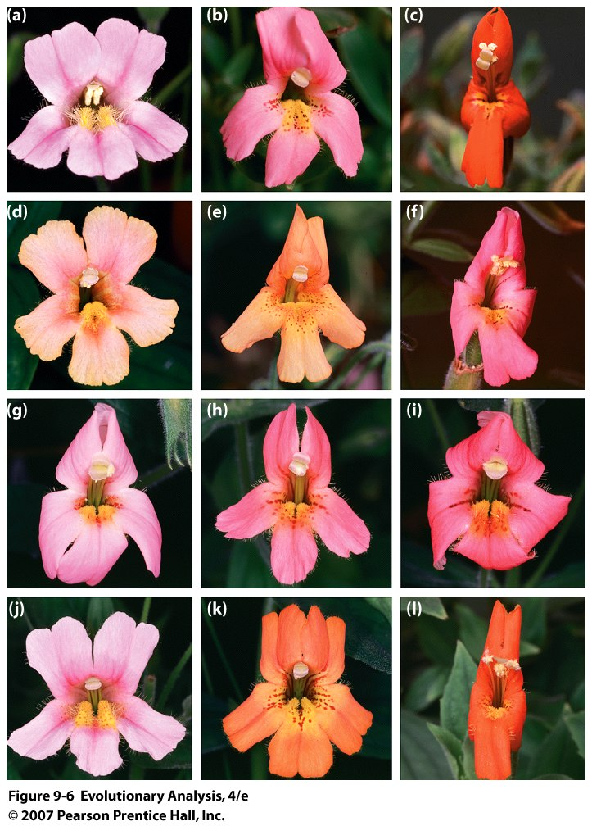
Segregation
Of floral types
Demonstrate
Genetic basis
Of trait
Differences
Notes:
Figure 9.6 Mimulus cardinalis, Mimulus lewisii, and their F₁ and F₂ descendents
Photo (a) shows M. lewisii, photo (b) shows an F₁ hybrid, and photo (c) shows M. cardinalis. The remaining photos (d-l) show F₂ hybrids produced by crosses between F₁s. The F₂s show wide variation in their floral characters. Reprinted from Schemske and Bradshaw (1999).

Slide 14
Convergent evolution??

Slide 15
Yosemite Sam thinks so

Slide 16
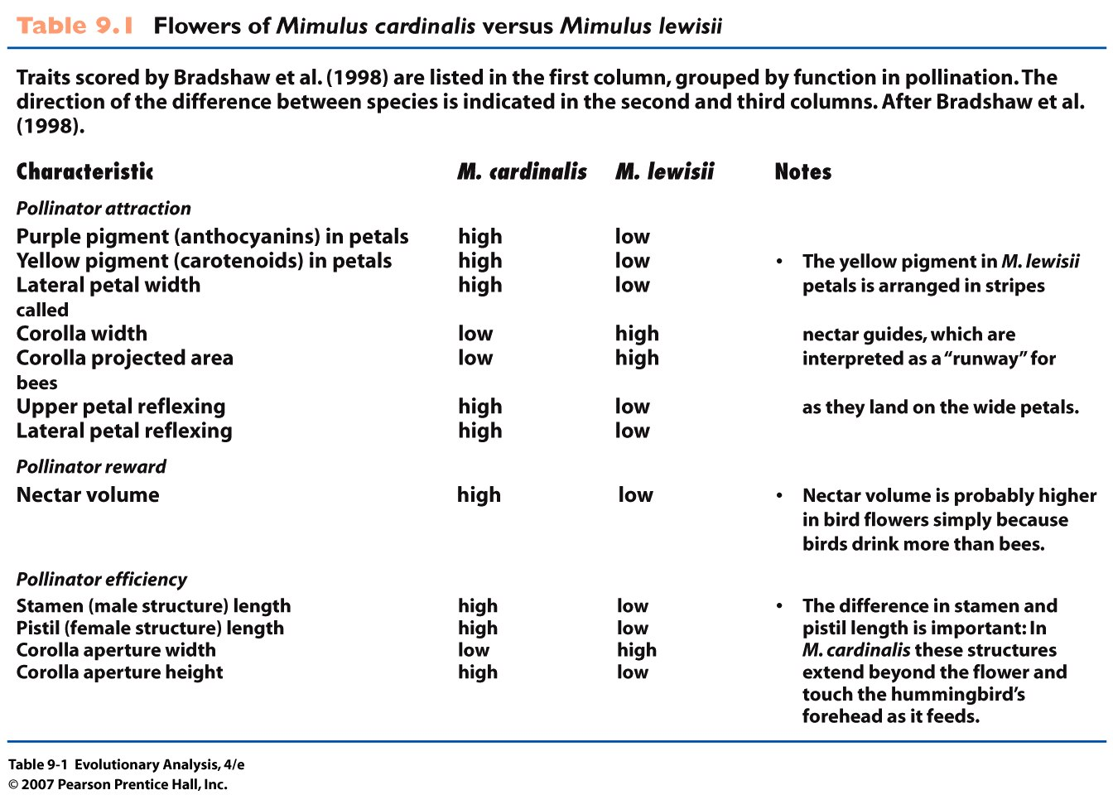
Notes:
Table 9.1 Flowers of Mimulus cardinalis versus Mimulus lewisii

Slide 17
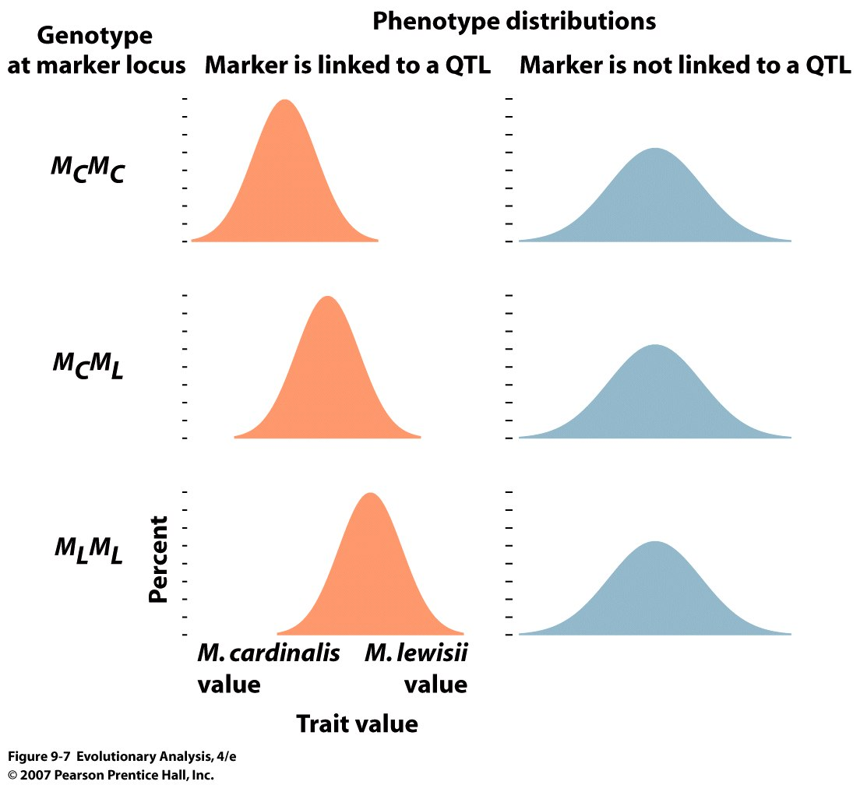
in the F2 generation
Notes:
Figure 9.7 The logic of QTL mapping
In QTL mapping, researchers start with parents from different species, cross them to produce F₁ hybrids, then self or intercross the F₁ hybrids to produce a large population of F₂s (see Figure 9.6). For each F₂ individual the researchers measure the phenotype for the quantitative trait of interest and the genotype at marker loci distributed across the genome. Finally, examining the entire F₂ population, researchers compare individuals with different genotypes at each marker locus. If phenotypes differ among individuals with different genotypes at a particular marker locus, as shown here on the left, then we can infer that the marker locus sits near a locus that contributes to the quantitative trait.

Slide 18
M_{C} Q_{c}
M_{L} Q_{L}
x
M_{C} Q_{c}
M_{L} Q_{L}
M_{C} Q_{c}
M_{L} Q_{L}
If the map distance is 5 cm then there is a 95% chance that
the marker will be associated with the QTL in the F2:
1- r(MQ)
Notes:
MCQC gamete = (1-r)/2
MLQL gamete = (1-r)/2
MCQL gamete = r/2
MLQL gamete = r/2
Vs unlinked

Slide 19
M_{C1} Q_{c} M_{C2}
M_{L1} Q_{L} M_{L2}
x
M_{C1} Q_{c} M_{C2}
M_{L1} Q_{L} M_{L2}
M_{C1} Q_{c} M_{C2}
x
x
M_{L1} Q_{L} M_{L2}
If the map distance between markers and QTL are 5 cm then
there is a 99.5% chance that one of the markers will be associated
with the QTL in the F2:
1-2 r(M1Q)(QM2)

Slide 20
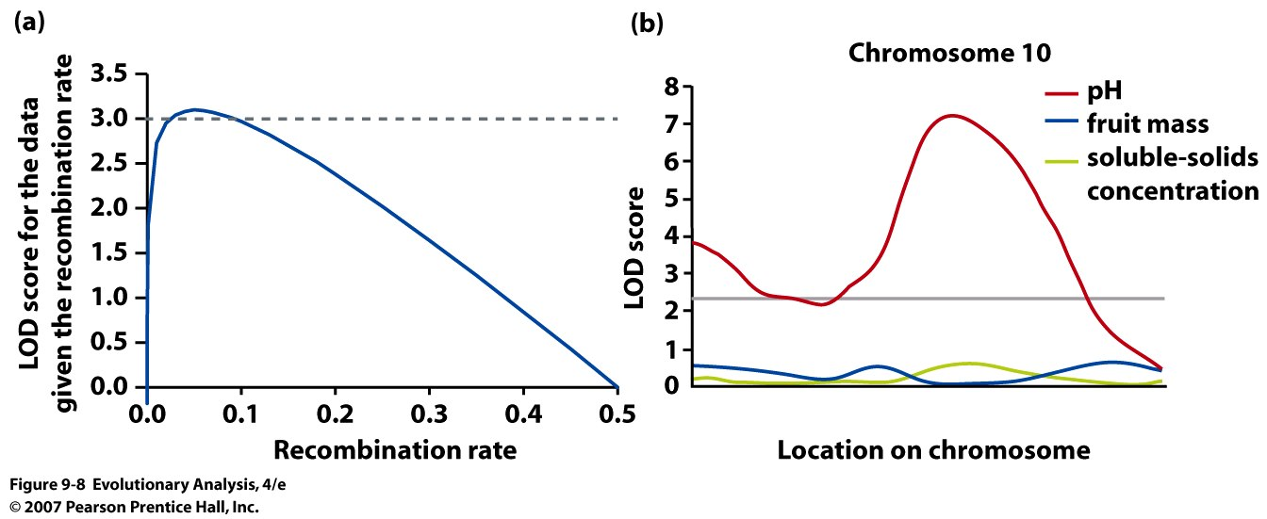
Notes:
Figure 9.8 Results from QTL mapping studies are often summarized with plots of LOD score
LOD score measures the degree to which we can better explain the data with a model in which a locus influencing phenotype is linked to the marker loci examined versus a model in which no such linkage exists. Where the LOD score crosses a threshold chosen by the researchers, the researchers conclude that there is evidence of linkage. (a) This graph shows LOD score as a function of recombination rate for our hypothetical example. (b) This graph shows LOD score as a function of chromosomal location for three quantitative traits in tomatoes. Rerendered from Paterson et al. (1988).
LOD stands for logarithm of the odds (to the base 10). A LOD score of three or more is generally taken to indicate that two gene loci are close to each other on the chromosome. (A LOD score of three means the odds are a thousand to one in favor of genetic linkage).
www.medterms.com/script/main/art.asp?articlekey=13053
One calculates the probability of producing an offspring of genotype with a certain linkage between the marker and the QTL vs free recombination (no linkage). One then divides the two probabilities for a likelihood ratio. We then take the Log of this likelihood and sum for every time we observe an individual exhibiting the linkage of marker with presumed qtl (inferred by phenotype)
See for more information: http://en.wikipedia.org/wiki/Likelihood-ratio_test

Slide 21
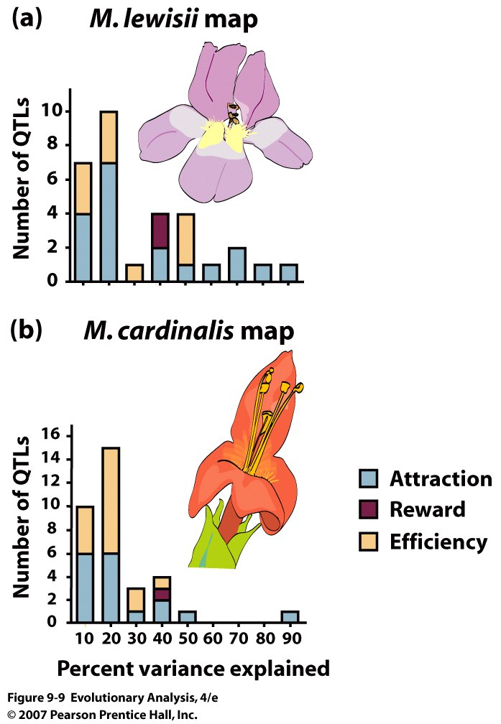
Notes:
Figure 9.9 QTLs for floral traits in Mimulus lewisii and Mimulus cardinalis, sorted by the strength of their effects on the phenotype
Bradshaw and colleagues (1998) found between one and six QTLs for each of the dozen floral traits they mapped. Differences in genotype for the majority of these QTLs explained only a modest amount of the variation in flower phenotype, as indicated by the higher bars on the left side of these graphs. However, for 9 of the 12 floral traits, there was at least one QTL at which differences in genotype explained more than 25% of the variation in phenotype. These QTLs with large phenotypic effects are indicated by the bars in the center and right of these graphs. There are separate graphs for M. lewisii and M. cardinalis because most of the marker loci used by Bradshaw and colleagues can only be detected in one species or the other. However, the QTLs themselves almost certainly occur in both genomes. Rerendered from Bradshaw and colleagues (1998).

Slide 22
Theoretical models that support or contend with the Darwinian model
2. Kimura’s
modification
1. Fisher’s prediction
Probability of Fixation
Mutation Effect
3. Orr’s modification
Alleles with a distribution of effect sizes
contribute to adaptations

Slide 23
III. Measuring Selection and Response to Selection
on Continuous Traits
Notes:
Figure 9.11 Identification of a quantitative trait locus influencing a personality trait
Sequence variation at the D4 dopamine receptor locus can be reduced to two categories of alleles: short (S) and long (L). Individuals with genotype LS or LL tend to score slightly but significantly higher on psychological tests of novelty seeking. Redrawn from Benjamin et al. (1996).

Slide 24
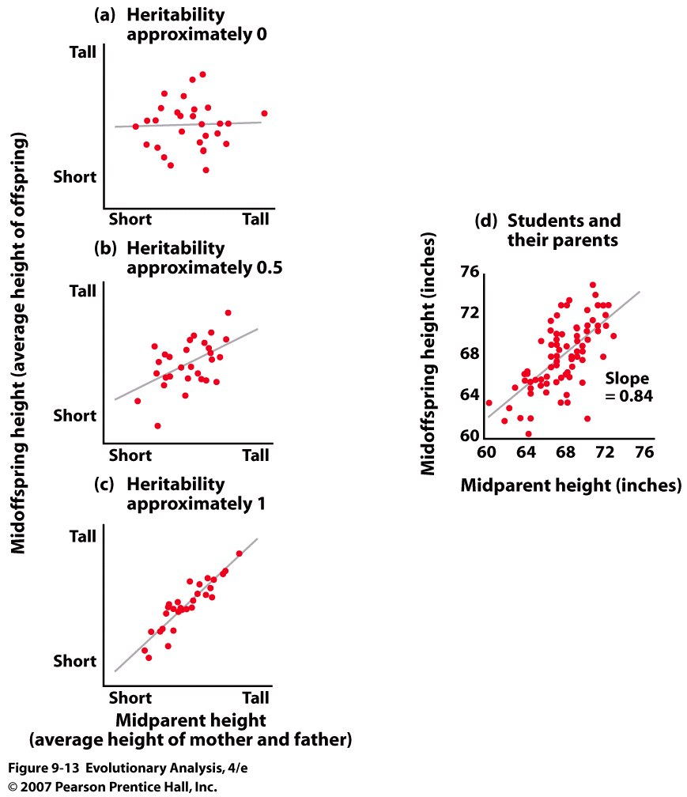
A. Heritability
Notes:
Figure 9.13 Scatterplots showing offspring height as a function of parent height
Each of the top three scatterplots shows data for a hypothetical population, and each includes a best-fit line through the data. (a) In this population, offspring do not resemble their parents. (b) In this population, offspring bear a moderate resemblance to their parents. (c) In this population, offspring strongly resemble their parents. (d) This graph shows data for an actual population of students in a recent evolution course at a university in the Pacific Northwest.
Narrow vs broad sense:

Slide 25
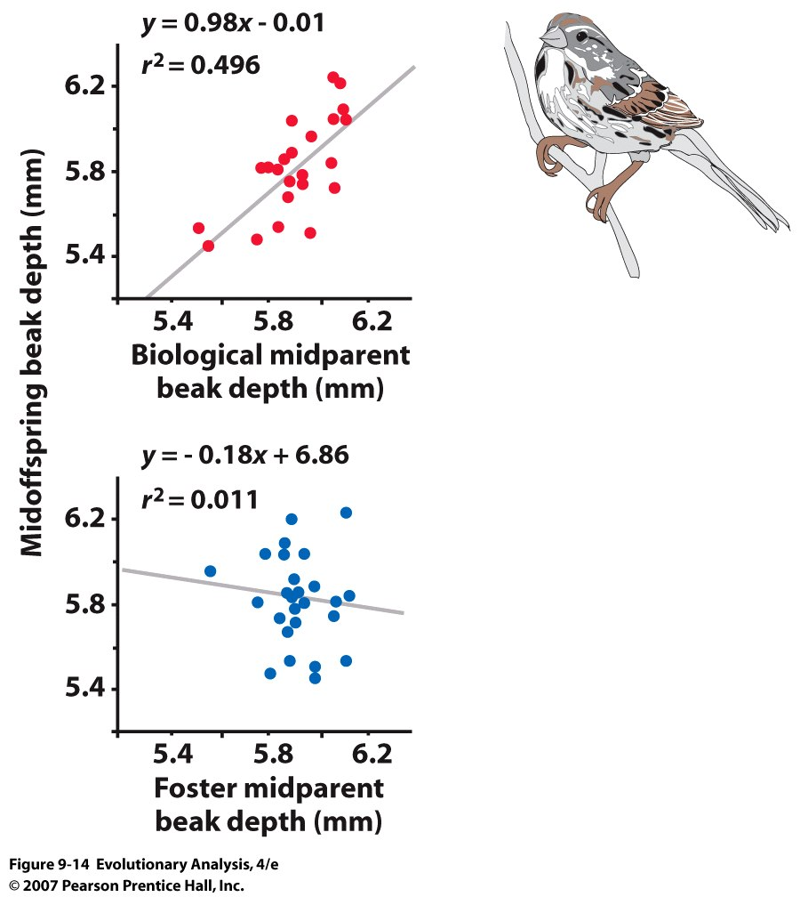
Song sparrows
Galapagos finches
Notes:
Galapagoes finches and song sparrows

Slide 26
Class
Data
Female Wt
Female HT

Slide 27
Male Wt
Male Ht

Slide 28
Heritability of Female Wt

Slide 29
Heritability of Female Wt

Slide 30
Heritability of Female Wt

Slide 31
Heritability of Female Ht

Slide 32
Heritability of Female Ht

Slide 33
Heritability of Female Ht

Slide 34
Heritability of Male Wt

Slide 35
Heritability of Male Wt

Slide 36
Heritability of Male Wt

Slide 37
Heritability of Male Ht

Slide 38
Heritability of Male Ht

Slide 39
Heritability of Male Ht

Slide 40
Conclusions from class data:
Distributions of Wts and Hts are roughly normal
Distribution indicates that Wts and Hts are likely controlled
by many loci, = many loci are segregating alleles that
contribute to wt and ht differences among individuals
Heritabilities for Ht >> WT
50% >> 30%
Interpretation for other human traits??

Slide 41
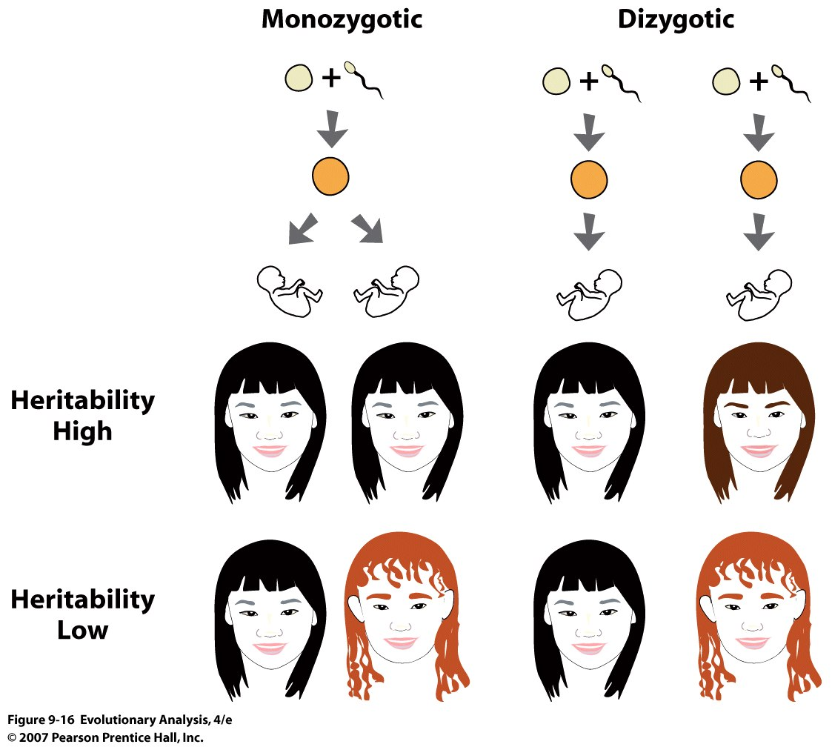
Black
Red
Red
Notes:
Figure 9.16 Estimating heritability from twin studies
Monozygotic twins develop from a single zygote, and thus share all their genes. Dizygotic twins develop from separate zygotes, and share half their genes. If the heritability of a trait is high, monozygotic twins will resemble each other more strongly than dizygotic twins.

Slide 42
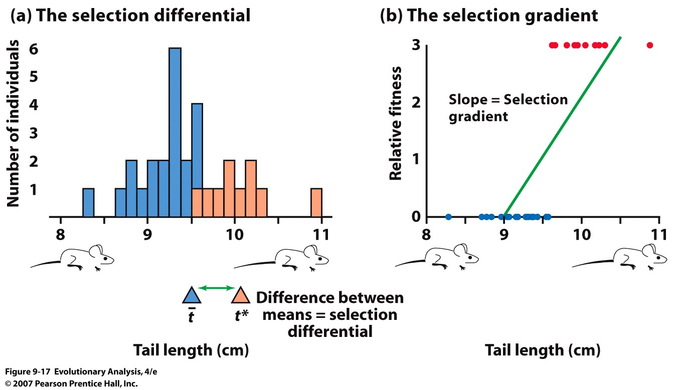
B. Selection
t
t*
S=
S= t* - t
Functional significance of trait
variation
Notes:
Figure 9.17 Measuring the strength of selection
The histogram shows the variation in tail length in a fictional population of lab mice. The red bars represent the mice chosen as breeders for the next generation. The gray triangle indicates the average tail length for the entire population; the red triangle indicates the average tail length for the breeders. The difference between these two averages is the selection differential. (b) A scatterplot for the same fictional population of mice showing relative fitness (see text) as a function of tail length. Red dots represent mice chosen as breeders for the next generation. The scatterplot includes the best-fit line (green). The slope of the best-fit line is the selection gradient.
Can Show that the numerator of a the regression coefficient is = to S

Slide 43
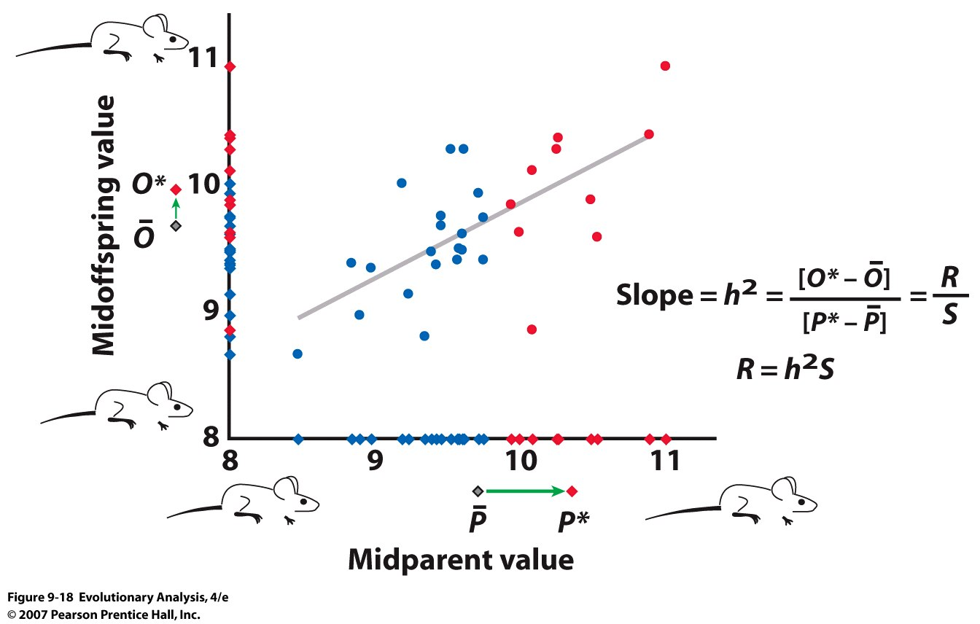
C. Response to Selection
The “2” term is meaningless, just an historical artifact of the derivation
Notes:
Figure 9.18 The response to selection is equal to the heritability multiplied by the selection differential
The midoffspring and midparent values are indicated both as dots on the scatterplot and as diamonds on the y- and x-axes. The red symbols represent the 10 families with the largest midparent values. P-bar is the average midparent value for the entire population; P* is the average midparent value of the families with the largest midparent values. O-bar is the average midoffspring value for the entire population; O* is the average midoffspring value for the families with the largest midparent values. After Falconer (1989).
Note that you do not have to “square” (=2) anything to get the heritability, just a silly artifact of its derivation.

Slide 44
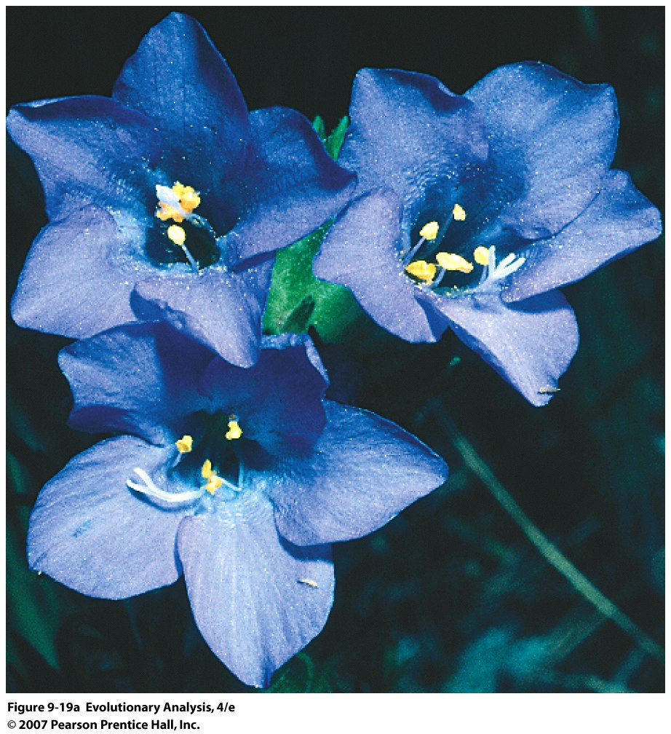
Notes:
Figure 9.19a An alpine skypilot and a bumblebee
(a) Alpine skypilot (Polemonium viscosum).

Slide 45
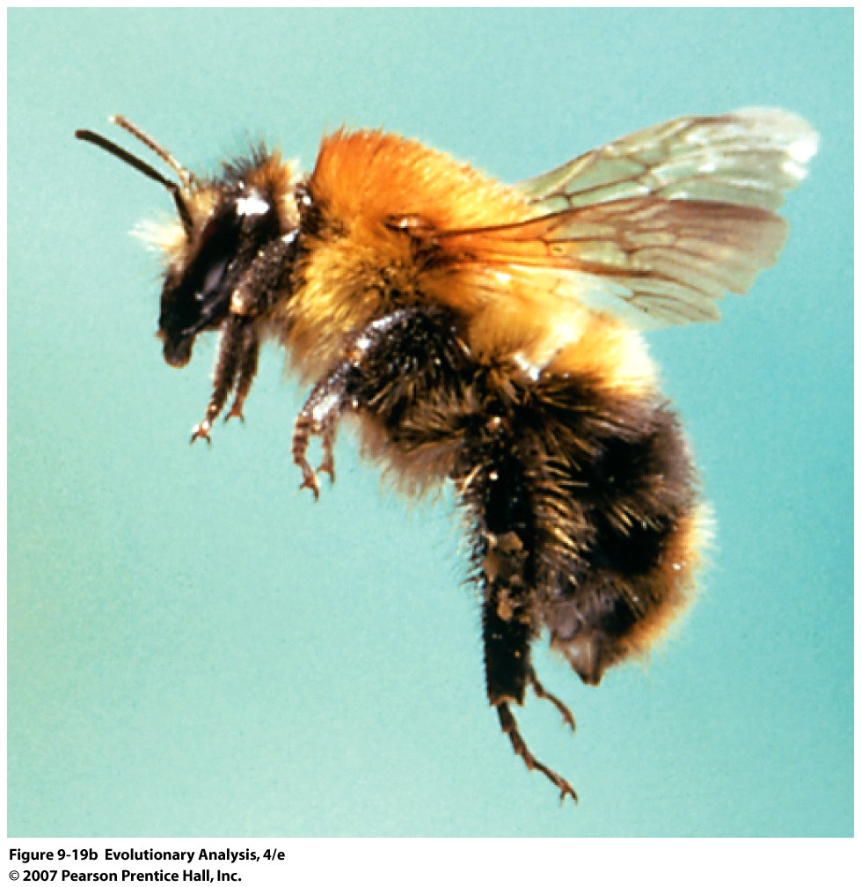
Notes:
Figure 9.19b An alpine skypilot and a bumblebee
(b) Bumblebee (Bombus sp.).

Slide 46
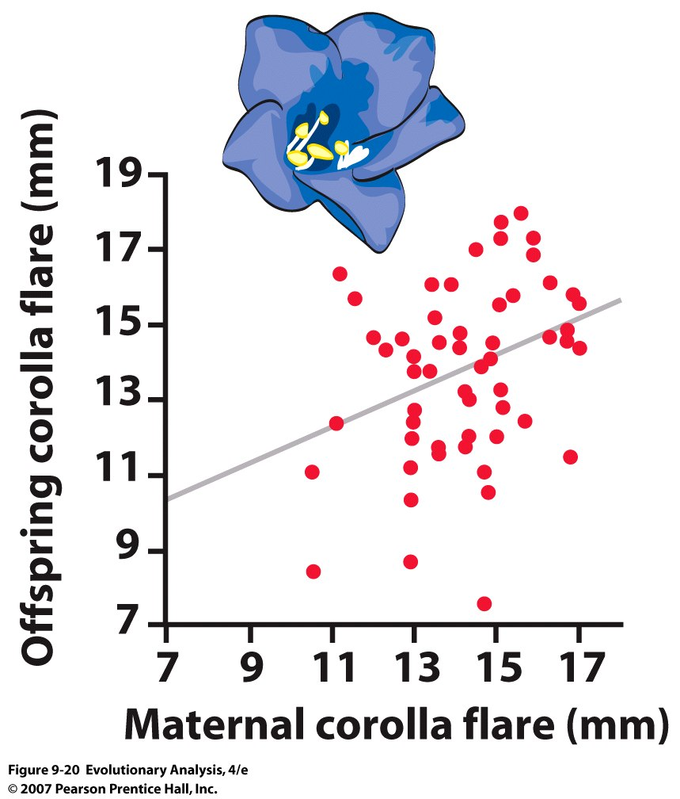
Notes:
Figure 9.20 Estimating the heritability of flower size (corolla flare) in alpine skypilots
This scatterplot shows offspring corolla flare as a function of maternal plant corolla flare for 58 skypilots. The slope of the best-fit line is 0.5. Redrawn from Galen (1996).

Slide 47
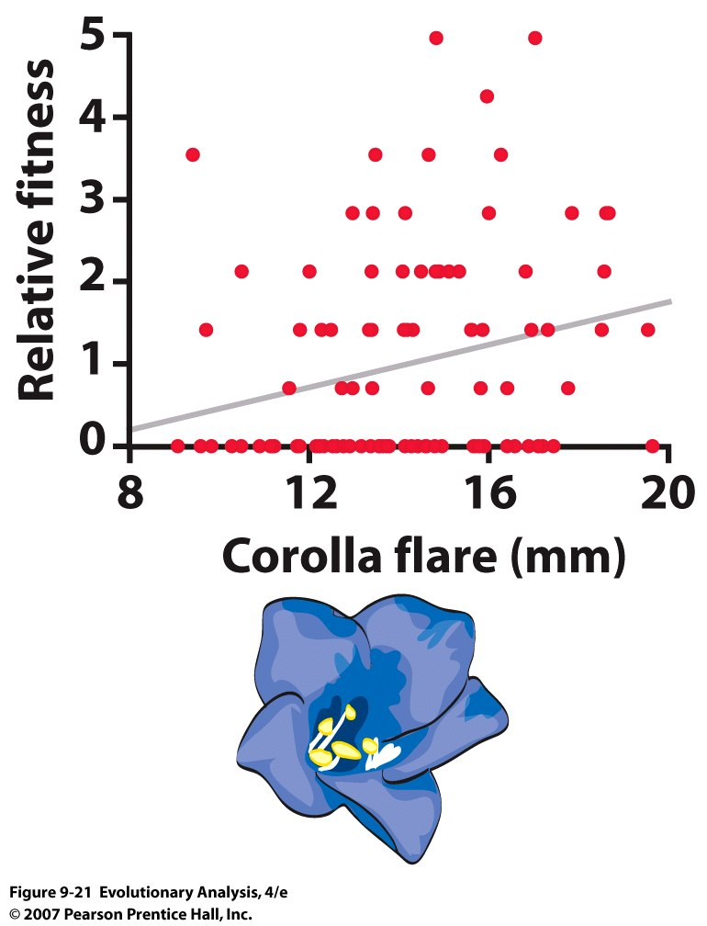
The slope of the best-fit line is 0.13
Notes:
Figure 9.21 Estimating the selection gradient in alpine skypilots pollinated by bumblebees
This scatterplot shows relative fitness (number of surviving 6-year-old offspring divided by average number of surviving 6-year-old offspring) as a function of maternal flower size (corolla flare). The slope of the best-fit line is 0.13. Prepared with data provided by Candace Galen.

Slide 48
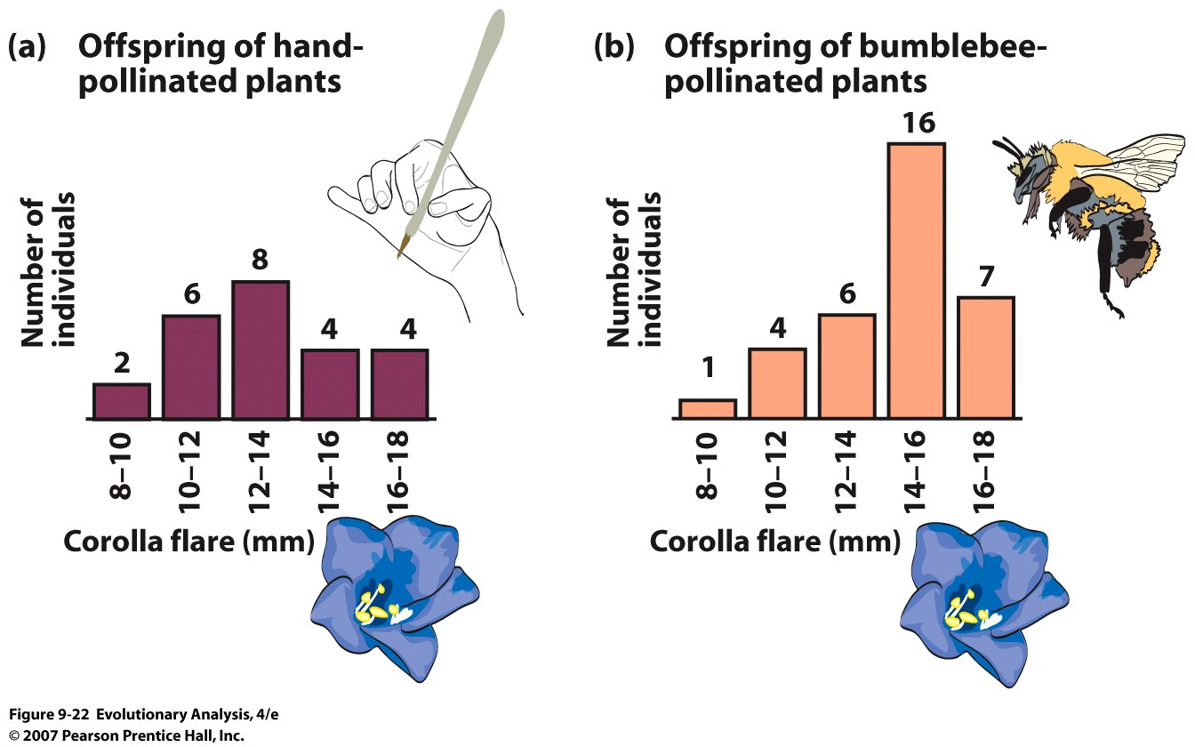
Notes:
Figure 9.22 Measuring the evolutionary response to selection in alpine skypilots
These histograms show the distribution of flower size (corolla flare) in the offspring of hand-pollinated skypilots (a; average = 13.1 mm) and bumblebee-pollinated skypilots (b; average = 14.4 mm). Redrawn from Galen (1996).

Slide 49
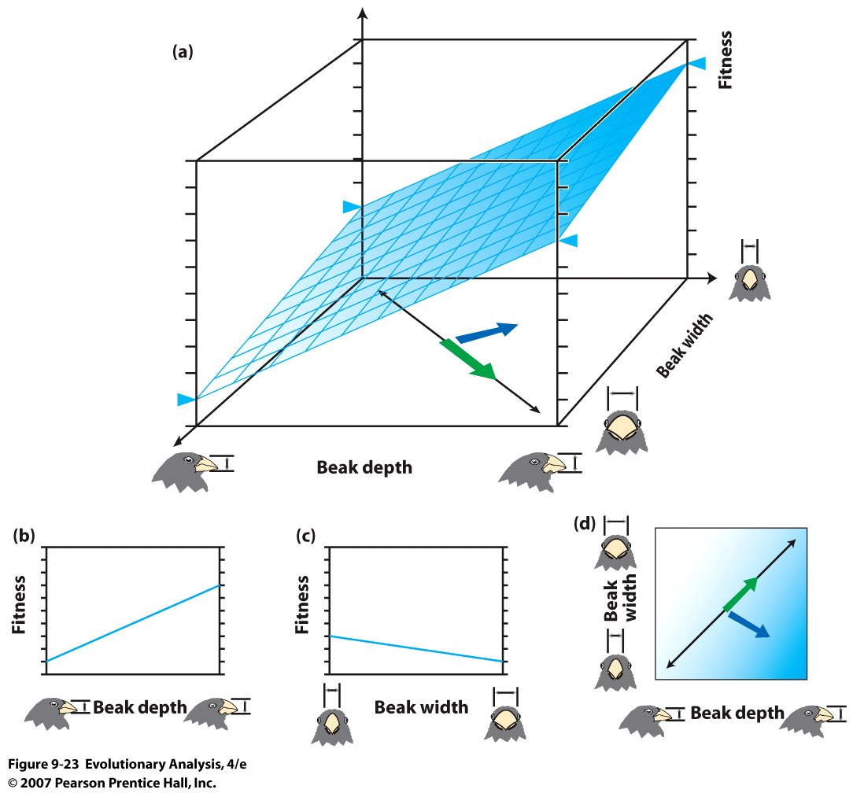
Notes:
Figure 9.23 A multidimensional analysis of selection on beak size in medium ground finches
(a) The grid plane shows the relationship between fitness and both beak depth and beak width. Birds with deep and narrow beaks had highest fitness. (b), (c), and (d) show the same scenario in two-dimensional graphs.

Slide 50
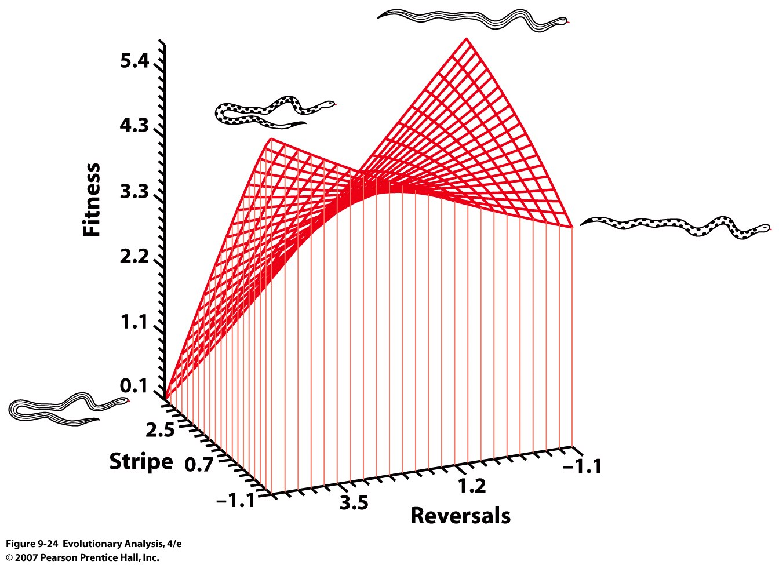
Notes:
Figure 9.24 A multidimensional analysis of selection on antipredator defenses in garter snakes
The grid surface shows the relationship between fitness and both color pattern and evasive behavior. From Fig. 1 in Brodie (1992).
Snakes that are striped are harder to judge speed so they should not reverse. Alternatively unstriped and reversals. Selection can select for trait combinations

Slide 51
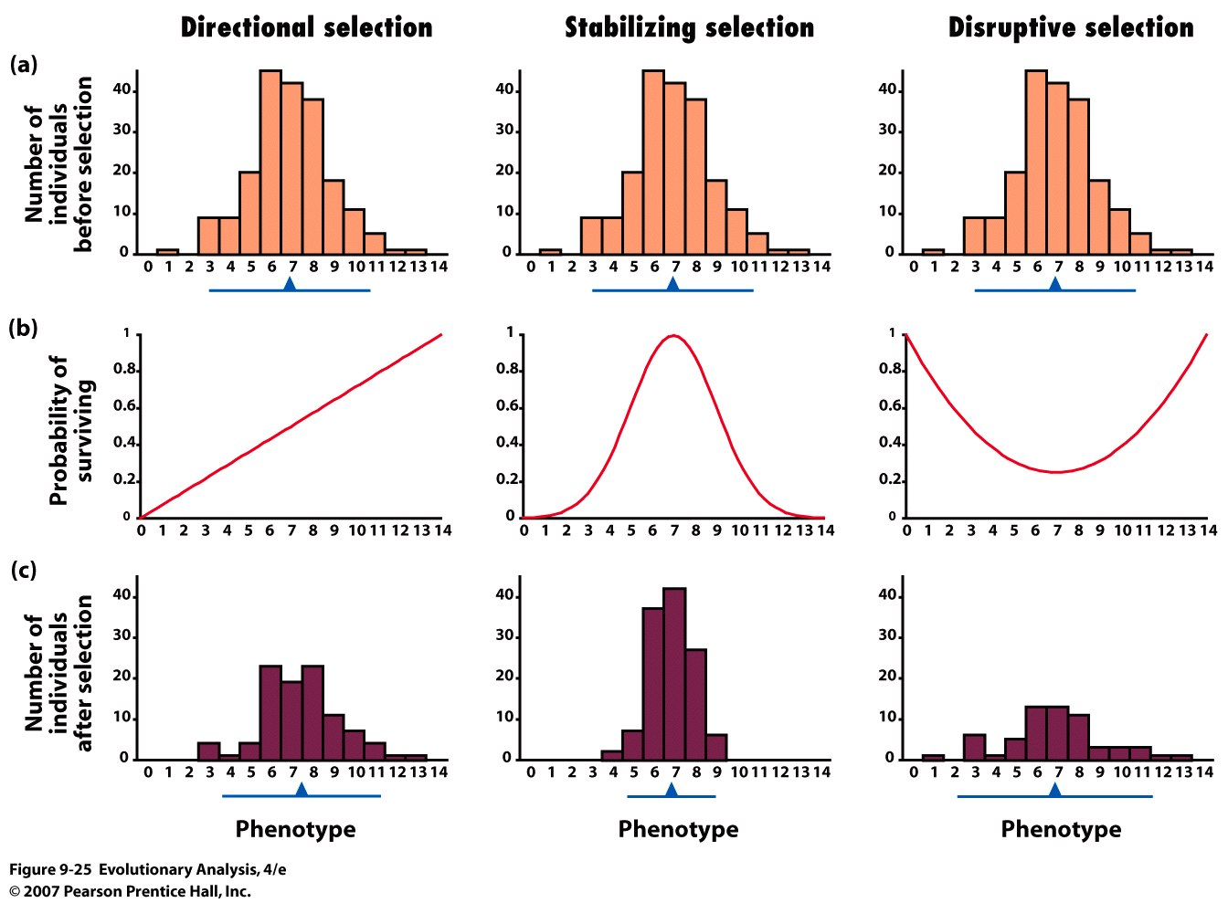
Notes:
Figure 9.25 Three modes of selection
Each column represents a mode of selection. The graphs in row (a) are histograms showing the distribution of a phenotypic trait in a hypothetical population before selection. The graphs in row (b) show different patterns of selection; they plot the probability of survival (a measure of fitness) as a function of phenotype. The graphs in row (c) are histograms showing the distribution of the phenotypic trait in the survivors. The blue triangle under each histogram shows the mean of the population. The blue bar under each histogram shows the variation +/- 2 standard deviations from the mean). After Cavalli-Sforza and Bodmer (1971).

Slide 52
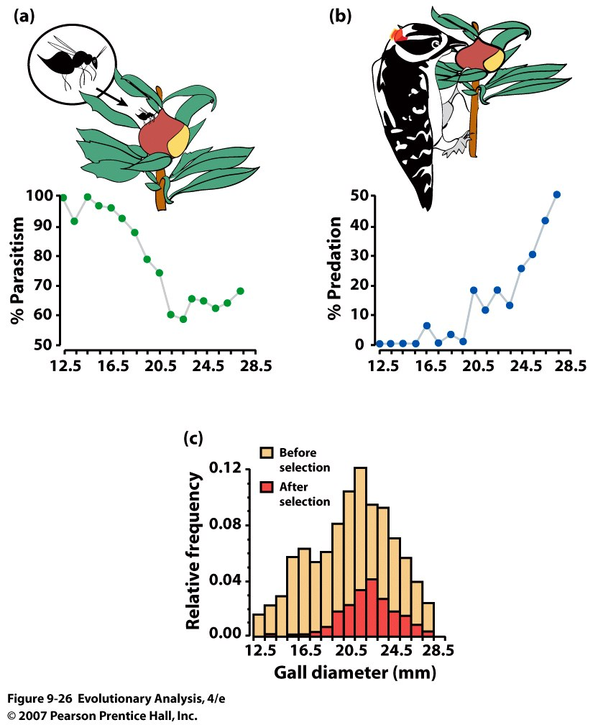
Stabilizing selection on a gall-making fly
Notes:
Figure 9.26 Stabilizing selection on a gall-making fly
(a) Parasitoid wasps kill fly larvae inside small galls at higher rates than they kill larvae inside large galls. (b) Birds kill fly larvae inside large galls at higher rates than they kill larvae inside small galls. (c) The distribution of gall sizes before (tan + red portion of bars) and after (red portion of bars) selection by parasitoids and birds. Overall, fly larvae inside medium-sized galls survived at the highest rates. From Weis and Abrahamson (1986).

Slide 53
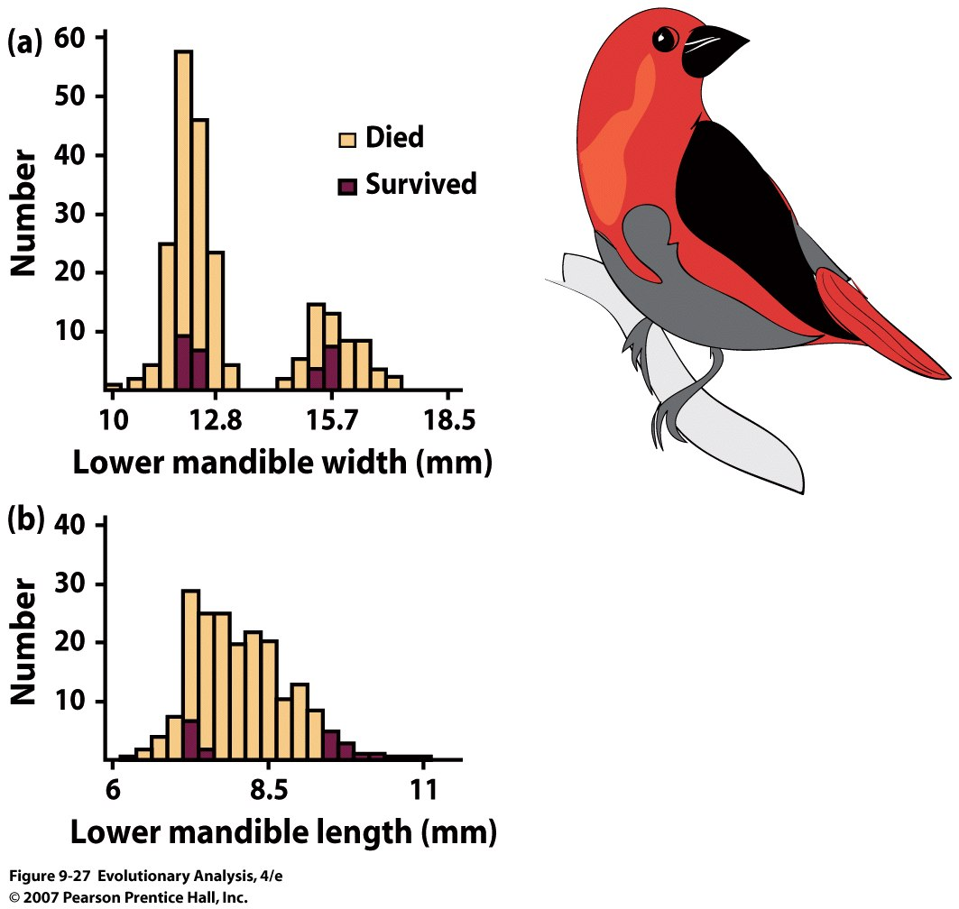
Disruptive selection on bill size in the black-bellied seedcracker
Notes:
Figure 9.27 Disruptive selection on bill size in the black-bellied seedcracker (Pyrenestes o. ostrinus)
Each graph shows the distribution of lower bill widths (a) or lengths (b) in a population of black-bellied seedcrackers, an African finch. The light-colored portion of each bar represents juveniles that did not survive to adulthood; the dark-colored portion represents juveniles that did survive. The survivors were those individuals with bills that were either relatively large or relatively small. Rerendered from Bates Smith (1993).

Slide 54
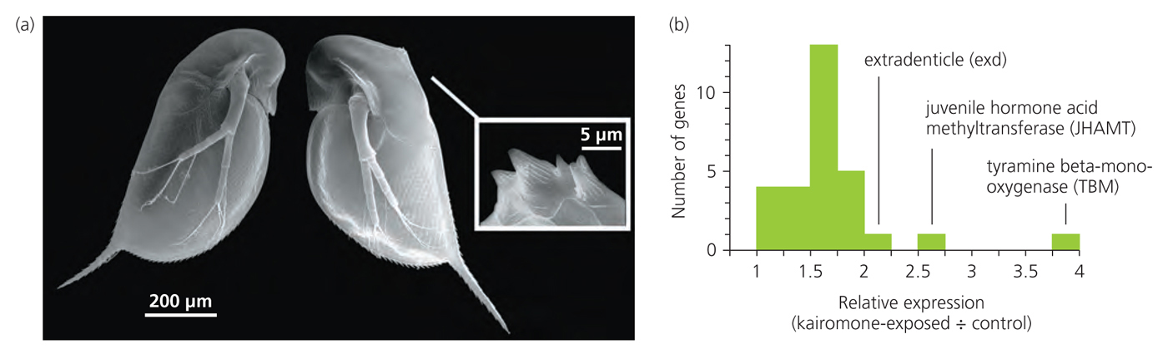
IV. Phenotypic Plasticity
Inducible defenses in Daphnia

Slide 55
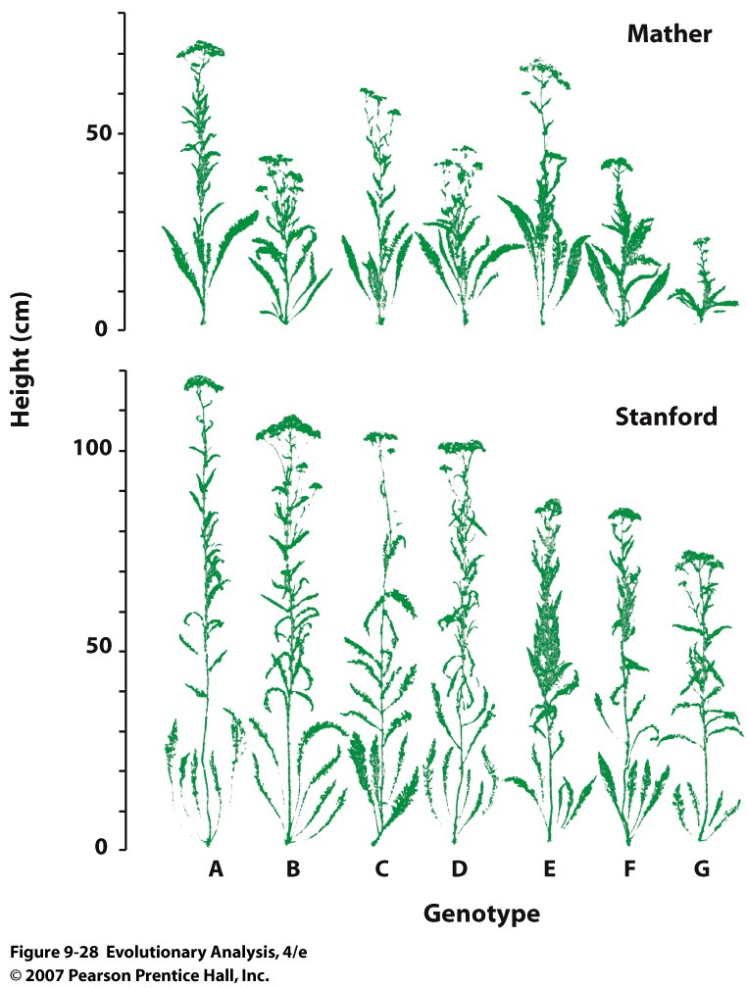
Genetic by
Environment
Interaction
in yarrow
Notes:
Figure 9.28 High heritability within populations tells us nothing about the cause of differences between populations
We know the variation in height among the plants within each of these populations is entirely due to differences in their genes, because the plants grew in experimental common gardens where all experienced the same environment. The plants in the Stanford population are taller, on average, than the plants in the Mather population. Does this mean that the Stanford population is genetically superior to the Mather population? No: We know these two populations are genetically identical because they were grown from cuttings of the same seven plants. Reprinted from Clausen, Keck, and Hiesey (1948).

Slide 56
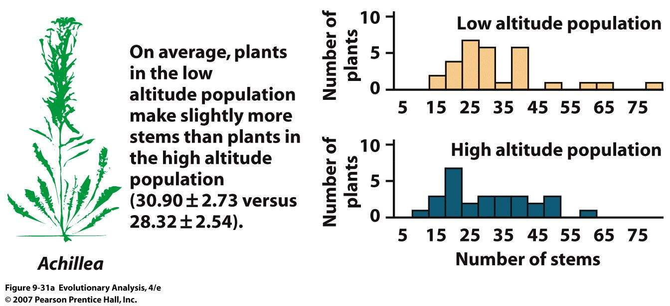
Notes:
Figure 9.31a Data from experiments by Clausen, Keck, and Hiesey (1948)
(a) A comparison between Achillea populations from low altitude (San Gregorio, California) versus high altitude (Mather, California).

Slide 57
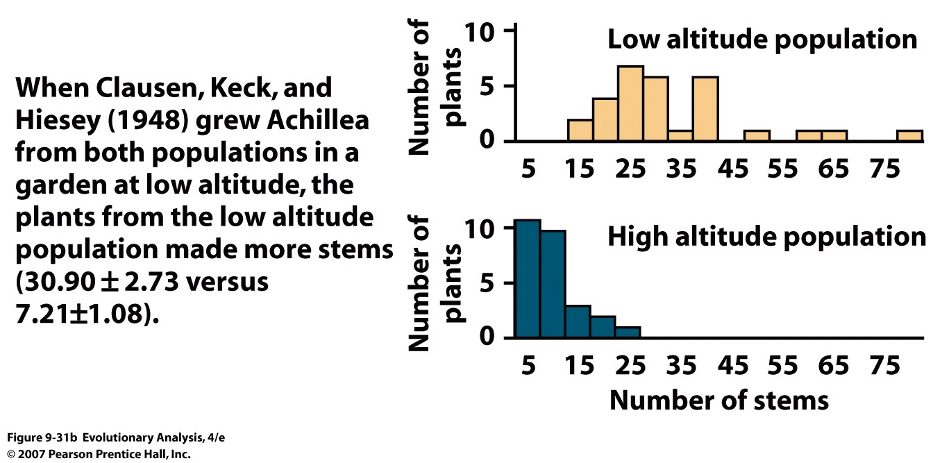
Low Altitude Site (Stanford)
Notes:
Figure 9.31b Data from experiments by Clausen, Keck, and Hiesey (1948)
(b) Plants from low and high altitude grown in a common garden at low altitude (Stanford, California).

Slide 58
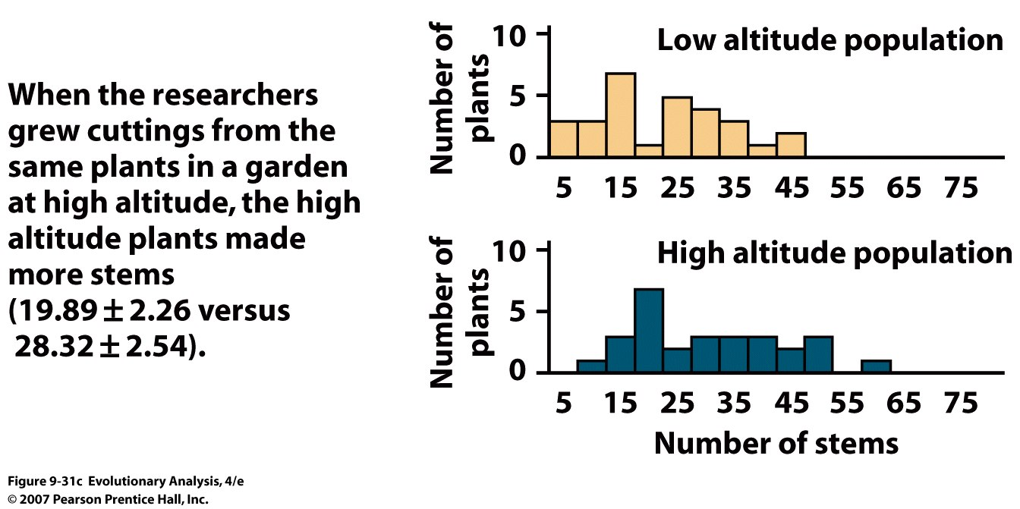
High Altitude Site, Mather California
Notes:
Figure 9.31c Data from experiments by Clausen, Keck, and Hiesey (1948)
(c) Plants from low and high altitude grown in a common garden at high altitude (Mather, California).

Slide 59
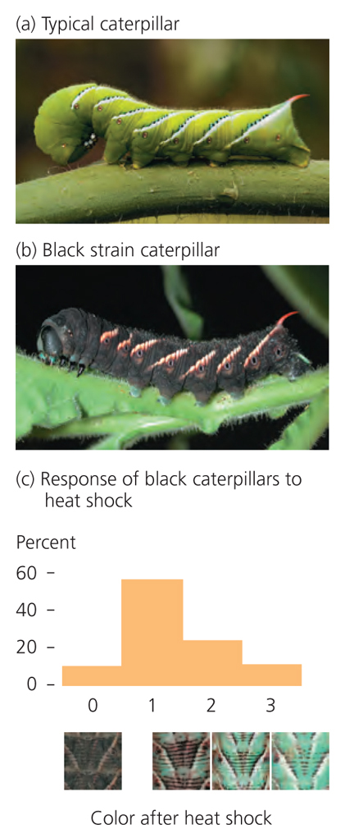
Plasticity can evolve

Slide 60
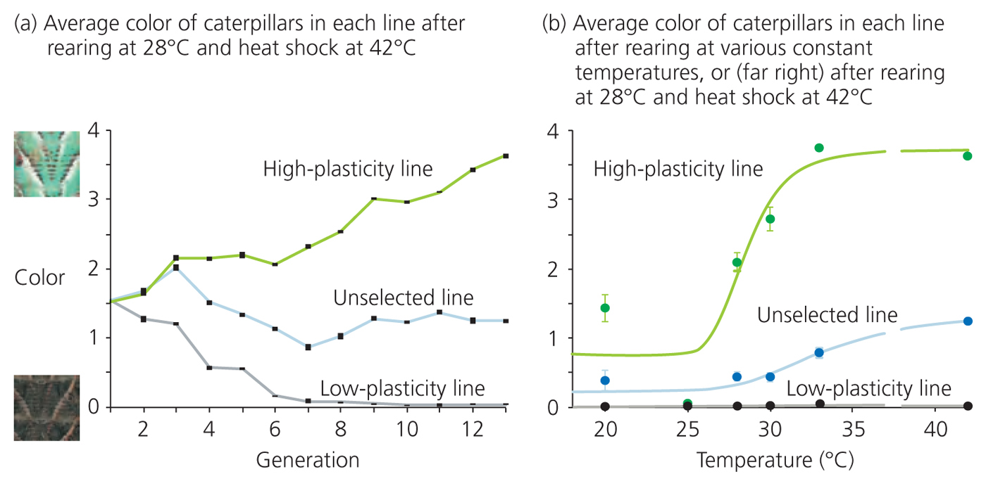

Slide 61
Conclusion
Continuous traits are common
Continuous traits can be heritable
Continuous traits can respond to selection
Darwin’s notion of natural selection acting on continuous variation is consistent with evidence
Genetic x Environment interactions may be important
G x E is a trait that can evolve

